Slide 1

Car Resale Price prediction
SAT 5165 - Intro to Big Data Analytics
Bhavani Chalamalla
Haranadh Ravi

Slide 2
Contents
Introduction
Data Overview
Data preprocessing
Model Building
Model Performance
Conclusion

Slide 3
1. INTRODUCTION
Goal:
To accurately predict the resale value of used cars by analyzing historical sales data using data science and machine learning techniques.
Significance:
This project aims to revolutionize the used car market by providing accurate price predictions, benefiting both sellers and buyers.
Enables more transparent and fair pricing, helping consumers make better-informed purchasing decisions.
Approach Overview:
Data preprocessing, exploratory analysis, and applying regression models.
Tools & Techniques:
Programming Language: Python
Libraries: Pandas for data manipulation, Matplotlib and Seaborn for data visualization, scikit-learn for machine learning.
Machine Learning Techniques: Regression algorithms (like Linear Regression, Random Forest,& Gradient Boosting).

Slide 4
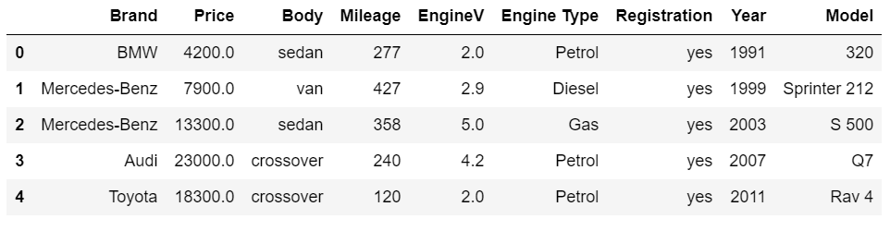
2. Data Overview
4345 total observations , 9 Columns (Features)
5 categorical variables
3 continuous variables.
1 response variable

Slide 5
Categorical variables Continuous variables
Brand
Body
Engine Type
Response Variable
Price
Mileage
EngineV
Year

Slide 6
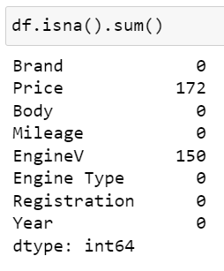
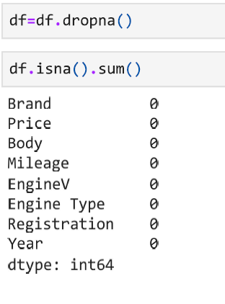
3. Data Preprocessing
We have missing values in 2 columns “Price” and “EngineV”. We have removed all null values as seen in Figure 2.

Slide 7
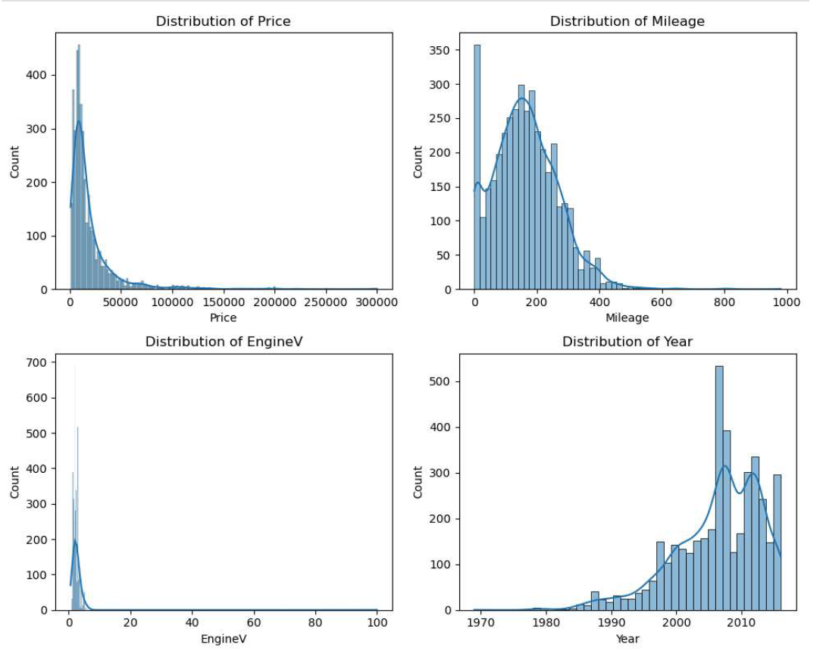
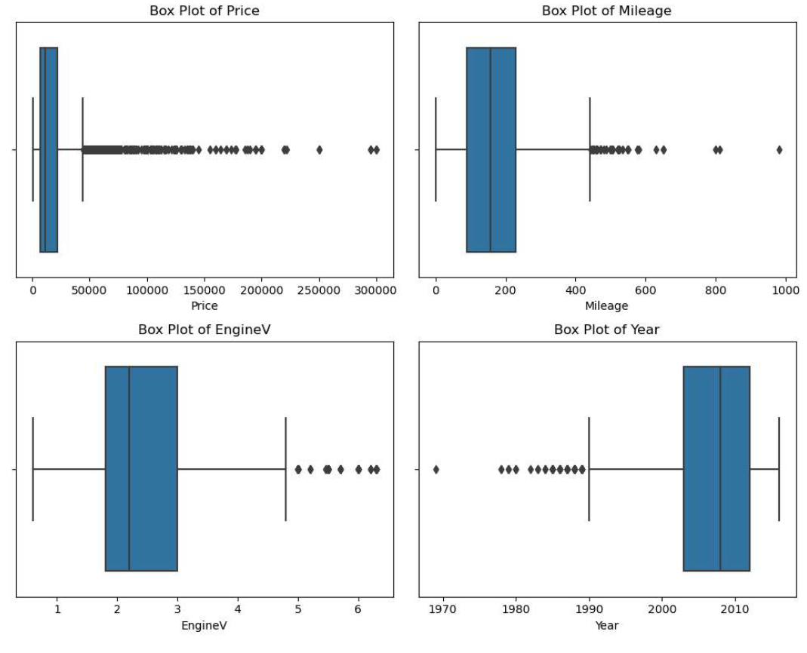
Distributions of Continuous Data

Slide 8
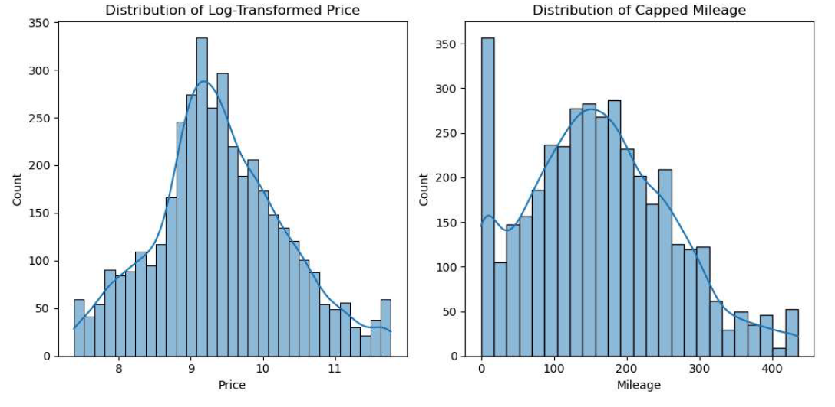
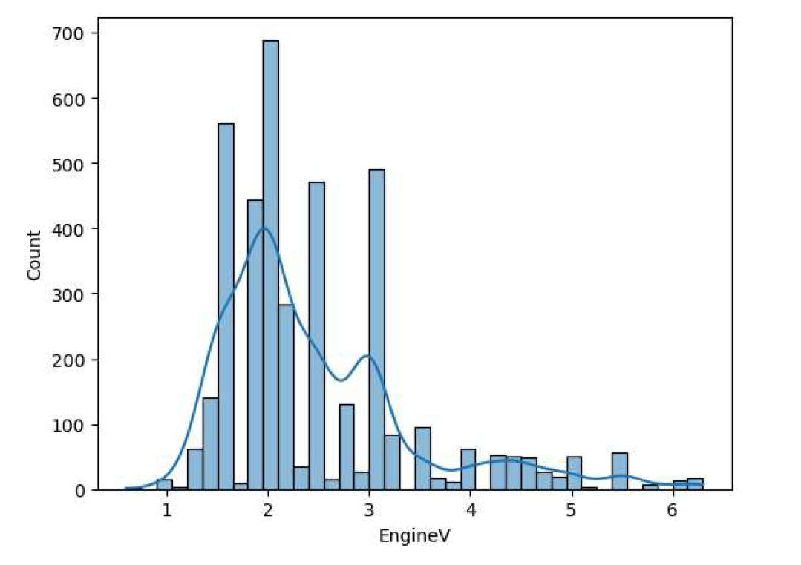
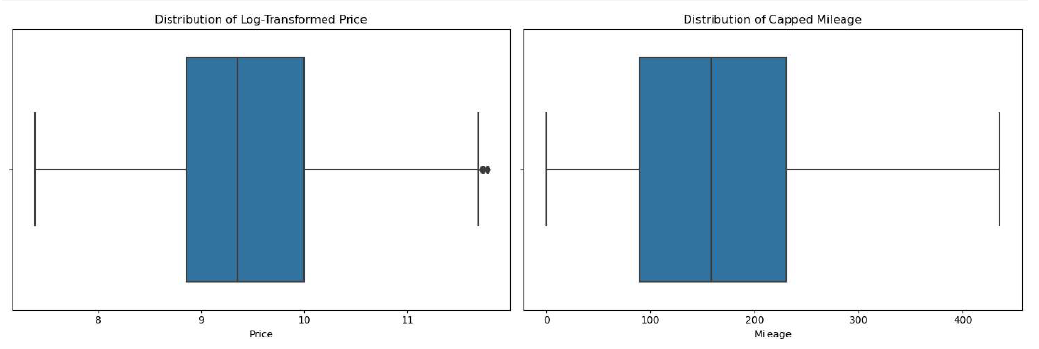
Continuous Data After Transformation

Slide 9
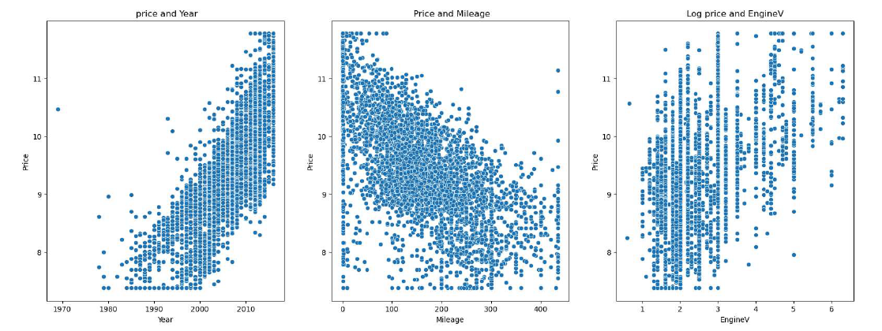
Pairs of Scatter plots after transformation
Evidence of linear relationships suggests linear regression suitability.
Predictable price movement with variable changes is ideal for linear regression.
Scatter plots emphasize the need for transformations and feature engineering for better model performance.

Slide 10
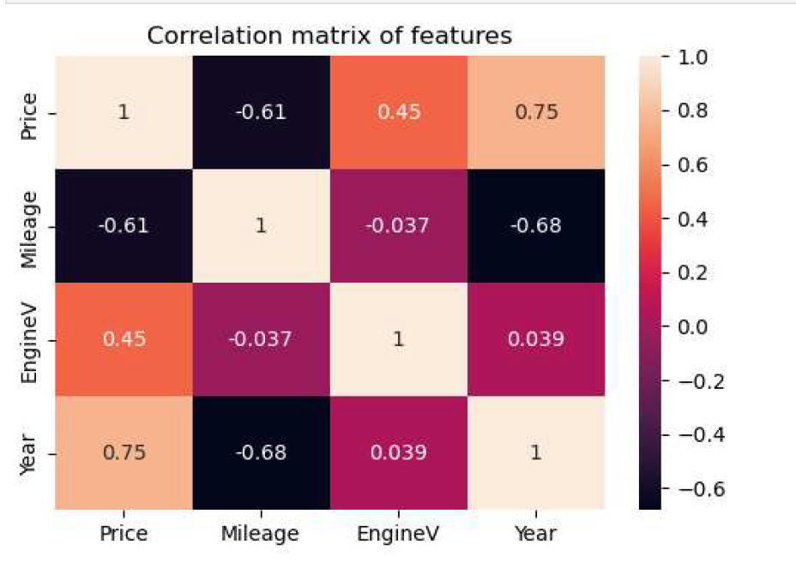
This correlation matrix gives us a snapshot of the relationships between key variables. For instance, we see a strong negative correlation of -0.61 between mileage and price, suggesting that higher mileage is associated with lower car prices. Conversely, the year of the car has a strong positive correlation of 0.75 with the price, indicating that newer cars tend to be priced higher. Engine volume (EngineV) shows a moderate positive correlation with price, at 0.45, hinting that cars with larger engines may command higher prices. These insights are pivotal in understanding which features are most influential in predicting the price of a used car.

Slide 11
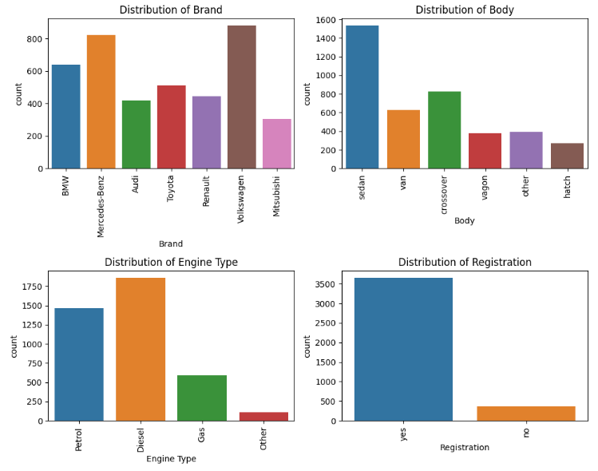
Distributions of Categorical Data

Slide 12
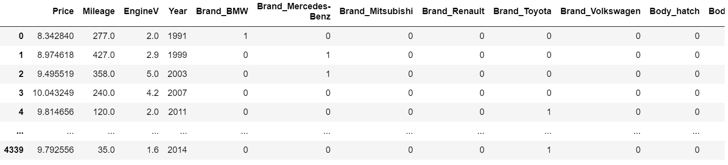
Conversion of Categorical data to Binary
After creating dummies the total number of columns are 19

Slide 13
4. Model Building
We have split our data into 80% training and 20% testing.
Regression Models
Linear Regression Model
Random Forest Regressor
Gradient Boosting Regressor

Slide 14
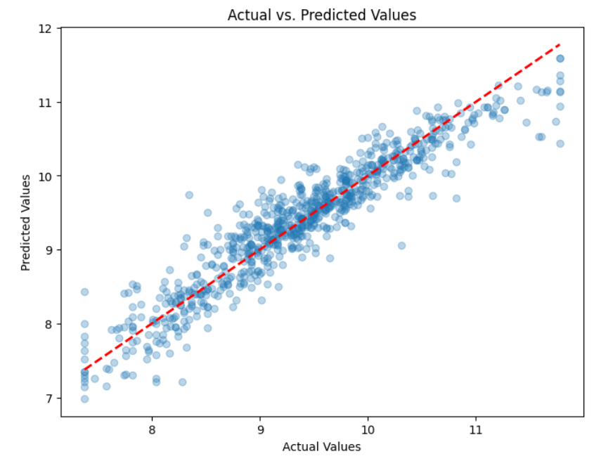

Linear Regression Model Performance
The model generally predicts accurately, as seen by the clustering of points around the perfect prediction line.
Deviations at higher values and scattered outliers suggest reduced accuracy in certain areas.

Slide 15
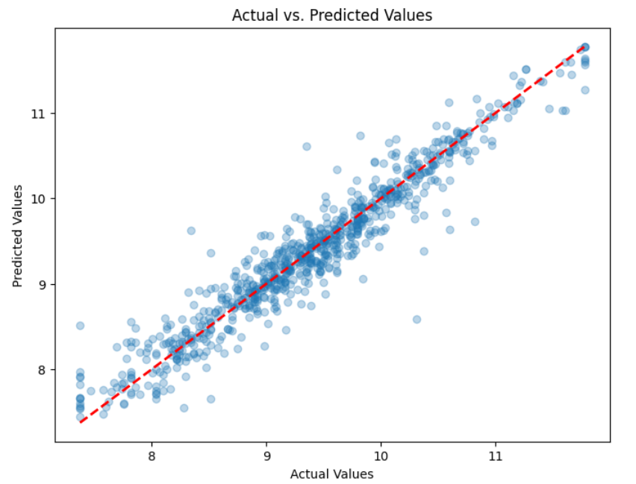

Random Forest Regressor
strong correlation between the actual and predicted values, indicating good model performance.
There is some scatter above and below the line of perfect fit, suggesting variability in the model's predictions.

Slide 16
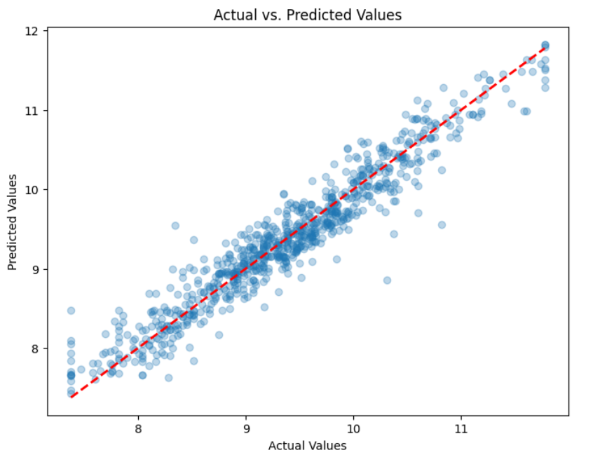

Gradient Boosting Regressor
The close clustering of points around the diagonal indicates the Gradient Boosting Regressor has a high prediction accuracy.
Despite the overall strong performance, there's a slight pattern of underpredicting at higher actual values, seen by the data points below the line.

Slide 17
5. Model Performance
Regression models | R2 | RMSE
Linear Regression Model | 0.8834 | 0.3066
Gradient Boosting Regressor | 0.9189 | 0.2559
Random Forest Regressor | 0.9187 | 0.2560

Slide 18
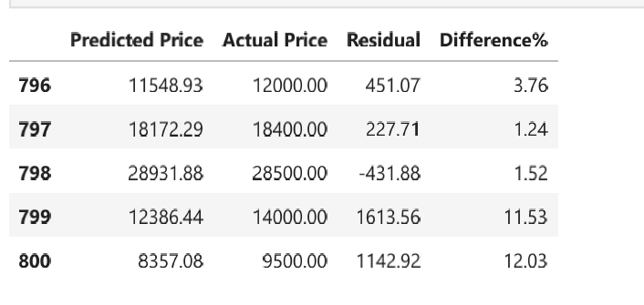
So as we try different Regression Algorithms and found that "GBT Regressor Model"is giving better accuracy compare to other models we check the predictions manually.

Slide 19
6. Conclusion
Random Forest Regressor: R-squared of 0.9187, RMSE of 0.2560.
Gradient Boosting Regressor: R-squared of 0.9189, RMSE of 0.2559.
Gradient Boosting shows a negligibly higher R-squared and a slightly lower RMSE, indicating a marginally better fit to the data.

Slide 20


